Slide 1
Capturing The Future For National Entertainment Network
Team Sulution
Bill Su, James Zhang, Zach Diamond

Slide 2
Introduction
National Entertainment Network is a part of the Entertainment Service industry. It provides entertainment and vending machines to its clients which are in turn consumed by end users. Our task today is to offer suggestions to improve NEN’s sales for 2015 and beyond.
We have focused on the demographic trends of customers as well as the seasonal trends of each separate machine group during our analysis. We will be presenting two recommendations to NEN: a short term remedy and a long-term solution.
Overview of NEN’s Performance
Short-Term Recommendation
Long-Term
Recommendation
Risk Analysis and Conclusion

Slide 3
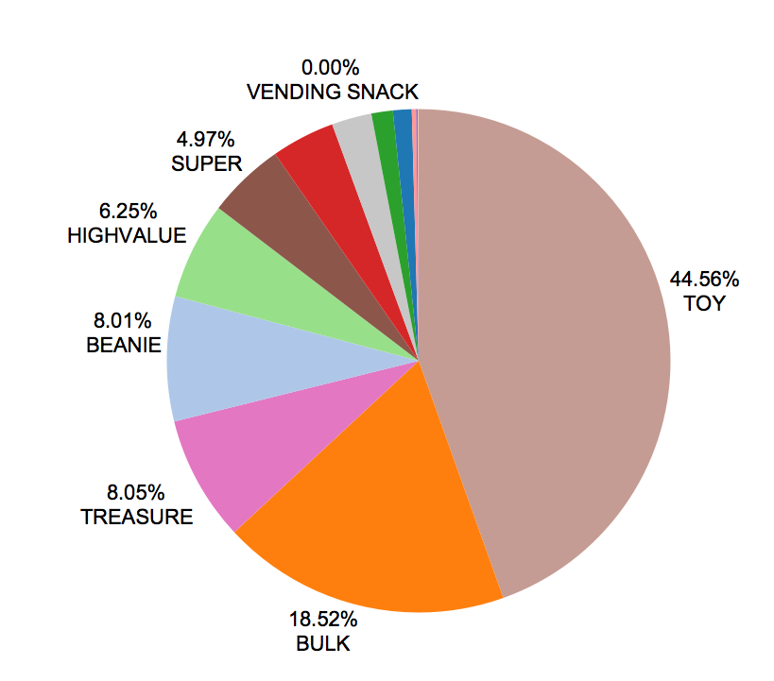
Macro Overview – Revenue overview
The Total Revenue of NEN has remained stagnant for the past few years. Our recommendations are geared to drive higher revenue for NEN.
The Toy and Bulk lines account for more than 50% of the revenue, followed by Beanie, Treasure, and High Value.
Meanwhile, the five weakest products only contribute 10% of the revenue.
“Dependency on selected products will harm NEN’s revenue potential.”

Slide 4
Current State and Overall Strategic Recommendation
Machine Group | 2011 Revenue | 2012 Revenue | 2013 Revenue | 2014 Revenue
AMUSEMENT | 465,631 | 1,151,585 | 1,222,856 | 1,551,239
BEANIE | 8,233,568 | 9,570,087 | 10,018,136 | 10,390,110
BULK | 24,131,618 | 25,612,880 | 25,150,002 | 24,023,907
CHANGER | 447,381 | 185,062 | 112,317 | 45,595
FUN | 1,351,929 | 1,506,361 | 1,597,128 | 1,777,106
HIGHVALUE |  | 5,463,289 | 6,865,512 | 8,106,165
KIDDIE | 5,870,329 | 6,065,450 | 5,638,841 | 5,299,589
LOWVALUE |  | 436,143 | 371,508 | 374,485
STOP | 2,682,121 | 427,775 | 16,799 | 2,843
SUPER | 6,959,341 | 6,097,840 | 5,959,388 | 6,443,805
TOY | 57,661,085 | 60,613,760 | 57,689,543 | 57,799,026
TREASURE | 13,636,734 | 14,429,955 | 11,839,887 | 10,441,387
VENDING PHAR |  | 8,824 | 10,249 | 1,389
VENDING SNACK | 36,095 | 15,972 | 11,523 | 3,031
VIDEO | 3,143,026 | 2,947,043 | 2,778,972 | 3,321,668
 |  | NEN Product and Return Type
Product | Amusement | Beanie | Bulk | Changer | Fun | High Value
Type | Game | Crane | Pay | Utility | Crane | Crane
Returns | No prize | Stuffed- toys | Small goods | Utility | Non- stuffed | High value
Age Group* | 5-15 yrs. | 5-15 yrs | 5-15yrs | N/A | 5-15yrs | 15-25 yrs
Product | Toy | Treasure | Vend-Snack | Video | Vend-Pharmacy
Type | Crane | Crane | Pay | Game | Pay
Returns | Toy | Non- toys | Snack | No prize | Medicine
Age Group* | 5-15 yrs. | 10-20yrs | All Age | 15-25yrs | All Age
*Categorization of age group merely represents an approximation of customers consuming these products to provide reference, rather than from actual demographic data
NEN is currently targeting the 5-15 year old age group with machines that provide medium value rewards.
However, all machines in this group have been stagnating except for High Value ( which is growing at 25% per annum).
Short Term – Consolidation and enhancement of major revenue sources.
Long Term- Introduction of high reward machines that target 15-25 year olds.

Slide 5
Short Term Remedy - Overview
“NEN’s revenue stagnation was caused by overreliance on selected product lines. Therefore, it is necessary to update the product portfolio of NEN for continuous growth. However, since the long-term solution will be lengthy and time consuming we have proposed short-term solutions to boost revenue growth.”
We propose three short-term solutions for NEN’s current Machine Portfolio
Consolidating NEN’s product portfolio by phasing out the least productive six lines. This will allow NEN to focus on growing high revenue sectors.
Integrating Toy, Treasure, Beanie and High Value with smart phone technology so as to create loyalty reward programs as well as in-game interaction.
Changing the content of bulk machines to include items of increased relevance to the new generation. This will boost consumption from the existing consumer population.

Slide 6
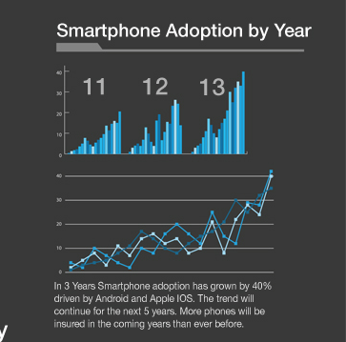
Digitally Integrate Currently Successful Machines and Creating a Reward Program
The rise of smartphones is disrupting NEN machines like Toy by serving as an entertainment substitute.
NEN is able to reduce the negative impact of smartphones by integrating its system with them in order to create an application and online reward program for frequent users.
Introduction of the NEN application will increase customer loyalty and create unprecedented in-game interaction for NEN customers.
Bulk, however, will not participate in this digital upgrade due to the minimal amount of revenue collected per machine.

Slide 7
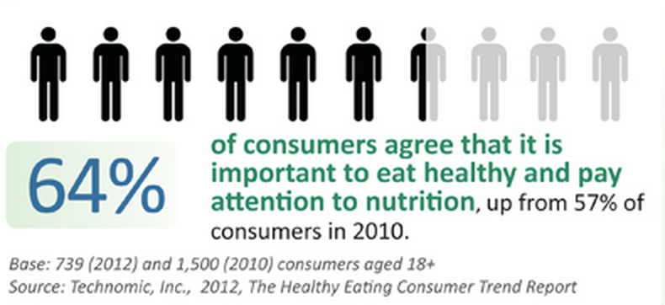
Update Bulk to Become More Culturally Relevant
Healthier Lifestyle
Change in Toy Trend
MAKER MOVEMENT- the Building Sets and Arts & Crafts categories grew by 13% and 3%, respectively, proving that kids love to create interesting structures, designs, inventions and other projects that will set them apart from others and let their talents shine through.
TOP IN TECH - the toy industry continues to draw on new technologies to create “Top in Tech” toys and youth electronics.
MINI MADNESS - toys that come in tiny packages, as well as smaller versions of hot-selling existing product lines.
(toy industry association inc.)
The products sold in Bulk must be switched to products that reflect the growing importance of living a healthy lifestyle by reducing the amount of machines currently selling candy.
NEN should increase Bulk machines that dispense toys which reflect the increasing popularity of technology, miniatures, and customizability in the toy industry. Items such as miniature legos, figurines, and items that showcase electronic features.

Slide 8
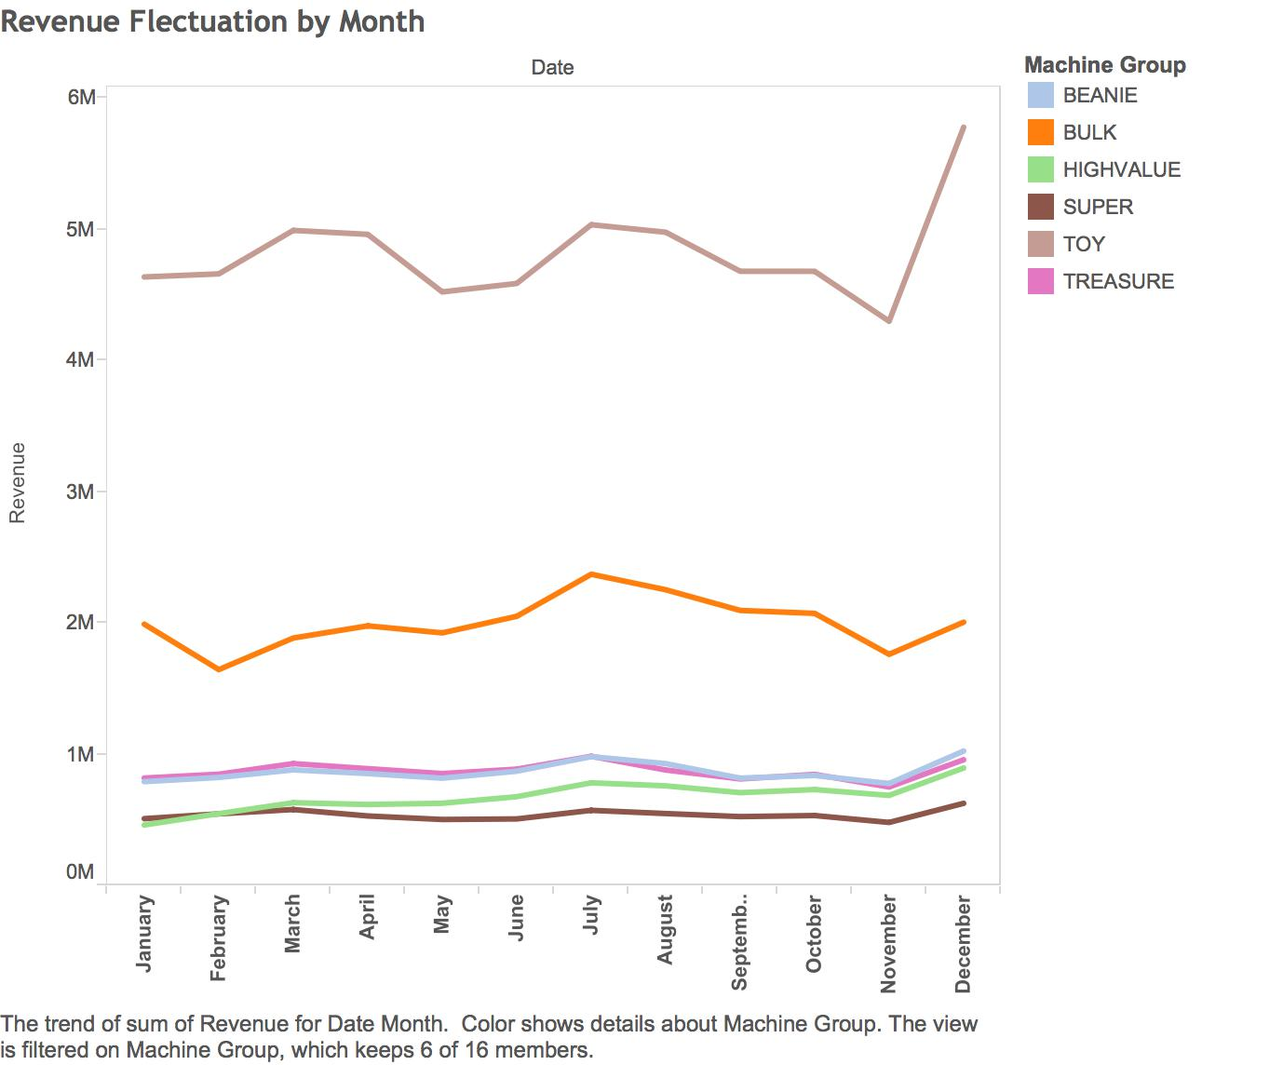
The 2015 Marketing Campaign Should Be Based on Seasonality
June-August
Develop digital platform
Collect Bulk sale data
Dec. to Jan.
Collect Toy sale data
April – May
Launching new bulk in Great Plains*
Start phasing out low revenue products
Oct. - Nov.
Introduce the digital platform for Toy and etc.
in Michiana*
If the growth of Bulk exceed 10%, implement new Bulk in all regions.
If the growth rate of Bulk is between 5% - 10%, introduce bulk in regions with high profitability.
If the growth rate of Bulk is below 5%, reevaluate the plan.
Apply the same criteria for introduction of the digital platform.
Before implementing changes in Bulk and introducing the new Digital Platform nationwide, both plans should be tested first in regions that have experienced stagnation for the past few year.
*See appendix: revenue growth by region for detailed analysis.

Slide 9
Long-Term Solution: Introducing Products that Appeal to a New Customer Segment
Daily Average Revenue Per Machine By Machine Group
Machine Group | AMUSEMENT | BEANIE | BULK | CHANGER | FUN | HIGHVALUE | KIDDIE
Daily Average Revenue | 2.91532478 | 8.781285275 | 2.283008154 | 18.85519029 | 6.25095522 | 12.97198844 | 3.044760286
Machine Group | STOP | SUPER | TOY | TREASURE | VENDING PHAR | VENDING SNACK | VIDEO | LOWVALUE
Daily Average Revenue | 10.76805881 | 8.742132899 | 12.85084318 | 9.303731974 | 3.028920791 | 8.342122875 | 3.826148224 | 4.978500461
High Value and Stop, the two brands that target the 15-25 year old age group provide the most average daily revenue per machine for NEN.
The 5-15 year old demographic that NEN had targeted has now moved into the 15-25 year old age group and so in order to retain control of this segment, NEN must change their machine portfolio.
In order to improve NEN’s revenue potential over time, we recommend the introduction of more high reward machines that target the 15-25 year old (Millennial) age group because they generate more revenue for NEN per machine.

Slide 10
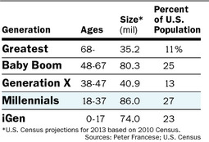
The Millennial Generation is
A Consumer of Entertainment
A Large Population
The Future of NEN
37% of millennials love shopping and 48% enjoy it. 27% prefer mass retailers like Target or Walmart for their shopping needs. 50% of millennial men and 70% of millennial women consider shopping a form of entertainment. (Urban Land Institute)
Vendor Type | 2011 Revenue | 2012 Revenue | 2013 Revenue | 2014 Revenue
Entertainment | 1,149,979 | 1,239,175 | 1,159,398 | 1,078,467
Grocery | 33,293,918 | 31,963,704 | 29,472,556 | 26,042,490
Hospitality | 3,089 | 8,521 | 11,221 | 18,191
Mall | 1,530,199 | 1,548,913 | 1,211,272 | 856,254
Mass Merch | 66,235,173 | 78,269,075 | 74,135,762 | 73,468,063
Other | 1,394,227 | 1,122,161 | 2,442,450 | 4,593,748
Restaurant | 20,678,831 | 20,138,725 | 20,662,926 | 22,424,919
Retail | 357,523 | 291,584 | 309,516 | 1,228,914
Not only is the millennial generation the largest in the United States at the moment, they shop and frequent locations that have been generating the most revenue and growth for NEN. Therefore, we believe by targeting the millennial generation, NEN can achieve great sales growth in the long-term.

Slide 11
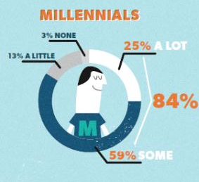
New Machine Rollout and Promotion Plan
Emphasize Digital Integration
Rollout in California
Utilize Social Media
High Value’s Revenue by Location
Social Media’s Effect on Purchase Decisions
 | 2012 | 2013 | 2014
Arizona | 370,942 | 476,869 | 478,029
California | 115,593 | 221,112 | 350,990
Chicago | 542,612 | 584,668 | 657,419
Great Plains | 563,110 | 740,677 | 856,301
Gulf Coast | 739,022 | 780,886 | 608,057
Michiana | 397,304 | 593,649 | 978,526
Mid Atlantic | 332,389 | 512,617 | 577,760
Mtn States | 411,673 | 439,678 | 586,045
Pacific NW | 524,227 | 657,165 | 719,990
Pittsburgh | 349,706 | 442,875 | 529,933
Southeast | 231,768 | 290,451 | 643,358
Texas | 849,450 | 1,058,774 | 1,082,946
60% of millennials say that it is convenient to have a smartphone or tablet to research or purchase a product or service on the go. Millennials also were more likely to share their location to receive coupons from nearby businesses (USA Today)
We have decided that California is the best place to rollout new machines not only because it is the fastest growing region, but also because it has the highest millennial population in the United States*.
In order to appeal to the millennial population, we recommend not only launching a social media marketing campaign, but also to continue the digital integration proposed in the short-term solution in order to appeal to millennial customers.
*See Appendix: U.S. Median Age by State

Slide 12
Risks and Potential future research
Short-term factors:
A slowing down of mobile usage among the targeted generation of 5-15 year olds could hamper our efforts at consolidation.
In addition, if our new products do not appeal to the population, it will be difficult to enhance major sources of revenue
Long-term factors:
A decrease in sales of High Value in the next few years will undermine current assumption.
The high reward machines invariably come with higher risk and cost for NEN.
Further Exploration:
Cost of installation and operation might vary between machine groups, which will provide further insight on which kind of machine is most profitable
Detailed demographic data of customers will be helpful in further analyzing most profitable customer segment. Collection will be enabled by digital platform.
Analyzing data collected after the introduction of the new Bulk and Digital Platform will provide more insights for the long-term solution.
“With our proposed short-term and long-term plan, NEN will not only improve revenue in the present, but also in the distant future. “

Slide 13
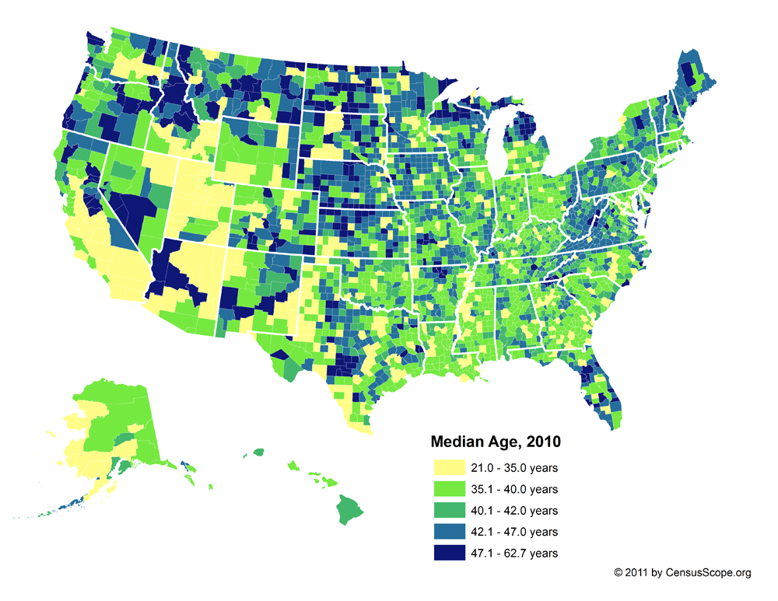
Appendix: U.S. Median Age By State

Slide 14
Appendix: Revenue Growth By Region (Toy and Bulk)
TOY | Arizona | 3,973,824 | 4,180,260 | 4,174,358 | 4,175,595
 | California | 4,990,465 | 5,340,419 | 5,686,013 | 6,310,841
 | Chicago | 4,886,346 | 5,231,152 | 4,604,489 | 4,607,281
 | Great Plains | 3,489,807 | 3,648,146 | 3,385,473 | 3,417,620
 | Gulf Coast | 4,086,753 | 4,058,602 | 3,666,350 | 3,618,727
 | Michiana | 4,536,060 | 4,964,642 | 5,197,313 | 5,025,854
 | Mid Atlantic | 6,689,232 | 7,349,713 | 6,858,618 | 7,039,539
 | Mtn States | 2,814,888 | 2,919,206 | 2,781,887 | 2,993,272
 | Pacific NW | 3,245,882 | 3,663,542 | 3,949,277 | 4,124,116
 | Pittsburgh | 5,939,703 | 6,111,249 | 5,655,323 | 5,635,205
 | Puerto Rico | 822,650 | 673,902 | 612,124 | 490,998
 | Southeast | 6,087,909 | 5,965,595 | 5,458,000 | 4,990,639
 | Texas | 5,358,027 | 6,052,746 | 5,622,664 | 5,358,044
BULK | Arizona | 1,772,799 | 1,917,843 | 1,898,172 | 1,930,011
 | California | 2,241,101 | 2,316,435 | 2,612,275 | 2,949,122
 | Chicago | 2,064,674 | 2,306,482 | 2,251,833 | 2,062,473
 | Great Plains | 1,349,388 | 1,486,215 | 1,566,512 | 1,473,153
 | Gulf Coast | 1,447,345 | 1,753,729 | 1,650,814 | 1,480,732
 | Michiana | 2,836,945 | 2,923,200 | 3,023,690 | 2,728,802
 | Mid Atlantic | 2,689,523 | 2,887,549 | 2,511,750 | 2,276,914
 | Mtn States | 1,470,130 | 1,631,126 | 1,597,072 | 1,669,856
 | Pacific NW | 1,426,456 | 1,559,570 | 1,466,168 | 1,623,359
 | Pittsburgh | 1,873,154 | 1,804,640 | 1,754,968 | 1,597,997
 | Puerto Rico | 329,974 | 337,568 | 279,381 | 261,950
 | Southeast | 2,611,365 | 2,521,923 | 2,449,808 | 2,014,714
 | Texas | 1,856,900 | 2,030,680 | 2,002,509 | 1,953,125

